Slide 1
Titanic Survival Data Micro-Project 4 Machine Learning Project 2 of 2 Repository link:
Jeremiah Snipes
August 31st, 2025

Slide 2
Problem Statement
We aim to determine whether being female, being a child, or other key passenger characteristics were strong predictors of survival on the Titanic, and by how much. Across the project, we will clean the data, build a reproducible pipeline, and develop models that estimate survival probability and explain the most influential factors.

Slide 3
Hypothesis Formulation
In the Titanic dataset, we expect to find that passengers who were female or under the age of 13 had a higher probability of survival than adult male passengers. This assumption comes from the historical “women and children first” evacuation practice, but it will need to be tested once the data is cleaned and prepared.

Slide 4
Acquire
Source: Kaggle “Titanic – Machine Learning from Disaster” CSV files (
Size: 1,309 rows × 12 columns.
Target column: Survived—populated for 891 passengers in the training set; missing for the 418 passengers in the test set by design.
Key variables: Pclass, Sex, Age, SibSp, Parch, Ticket, Fare, Cabin, Embarked.
Why this dataset: Well-documented, contains a mix of numeric and categorical features, and is suitable for building and testing survival prediction models across multiple project stages.

Slide 5
Prepare
Checked dataset structure using .info() and .describe() to review column types, non-null counts, and basic statistics.
Identified missing values: Age (263), Fare (1), Embarked (2), Cabin (1,014), Survived (418 test set, left unchanged).
Handled missing values:
Age → filled with median age within each Sex × Pclass group.
Fare → filled with median fare.
Embarked → filled with most common value (mode).
Converted data types: Pclass, Sex, and Embarked changed to categorical types.
Removed duplicate records based on Name and Ticket.
Created helper columns for later analysis: FamilySize and IsAlone.
Verified cleaning by rechecking missing values — only Survived (test rows) and Cabin remain missing by design.

Slide 6
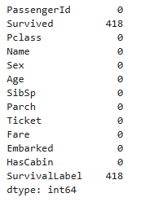
Prepare (Continued)
# Final check of missing values after cleaning
df.isna().sum()
418 missing in Survived is expected (test set). All other columns are now complete.

Slide 7
Analyze data
To explore the problem statement and test the hypothesis, I created five key visualizations highlighting how survival varied across passenger characteristics.
Survival Rate by Passenger Class
Age Distribution: Survivors vs Non-Survivors
Fare Distribution by Survival (Boxplot)
Correlation Heatmap (numeric variables)
Distribution of Passenger Ages (Histogram)

Slide 8
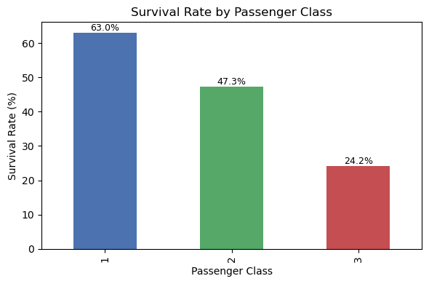
Analyze Data - Survival Rate by Class
First-class passengers had the highest survival rate at about 63%, while only around 24% of third-class passengers survived. This highlights the strong influence of socioeconomic status and access to lifeboats.

Slide 9
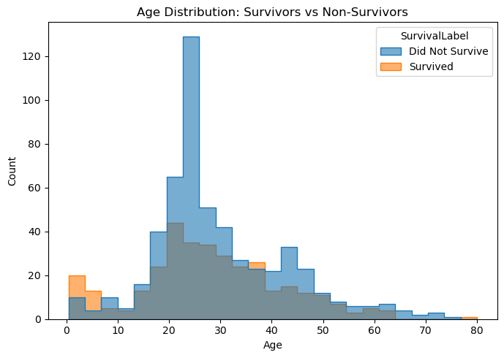
Analyze Data - Age Distribution
The age histogram shows that children under ~13 had noticeably better survival chances, while survival rates for adult males dropped sharply. This supports the historical “women and children first” evacuation practice.

Slide 10
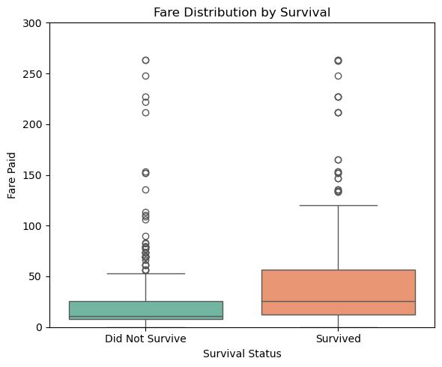
Analyze Data - Fare Boxplot
Passengers who paid higher fares were more likely to survive. The boxplot shows survivors clustered at higher fare levels, suggesting that wealth and class both played a role in who made it onto lifeboats.

Slide 11
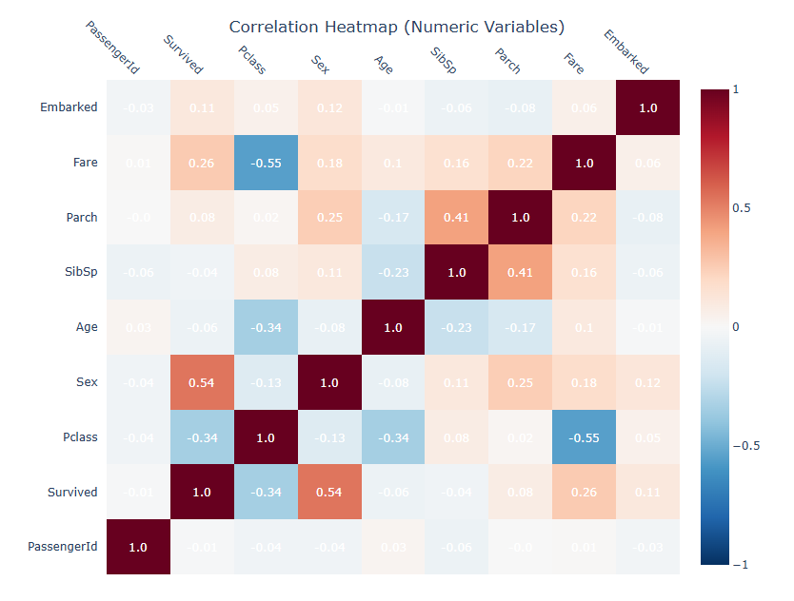
Analyze Data - Correlation Heatmap
Survival is most strongly correlated with sex, passenger class, and fare. Age shows a weaker but still visible effect. These variables together form the clearest predictors of who survived the disaster.

Slide 12
Report
Key Results
Women and children were more likely to survive, consistent with the “women and children first” practice.
First-class passengers had much higher survival rates (~63%) compared to third-class (~24%).
Higher fares were linked to higher survival, reflecting class and wealth effects.
Correlation analysis confirms sex, class, and fare as the strongest predictors of survival.
Age distribution shows children had an advantage, while survival rates for adult men were much lower.

Slide 13
Report (Continued)
Hypothesis: In the Titanic dataset, we expect to find that passengers who were female or under the age of 13 had a higher probability of survival than adult male passengers.
Result: Supported.
Data shows women and children had significantly better survival outcomes.
Class and fare added additional influence, with wealthier passengers more likely to survive.

Slide 14
Act: Final Model Selection and Recommendation
I tested four models: Logistic Regression, Support Vector Classifier (SVC), Linear Regression, and Support Vector Regression (SVR).
I created five visualizations to compare model performance in terms of precision, recall, F1-score, and accuracy.
Logistic Regression delivered the most balanced performance, achieving around 80% accuracy with consistent results across both survivor classes.
SVR slightly outperformed in raw accuracy (~81%), but it is a regression model not ideal for binary classification and lacks interpretability.
For real-world deployment, Logistic Regression is the most appropriate choice due to its balance of accuracy, simplicity, and explainability.

Slide 15
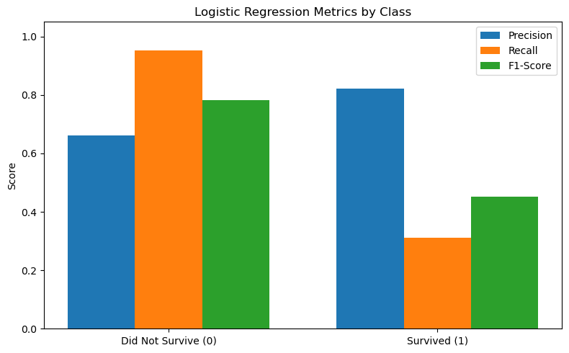
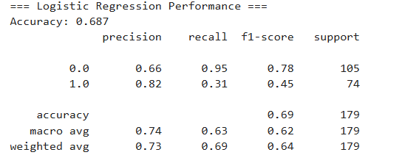
Act: Logistic Regression Model
Here, I used logistic regression to predict who survived the Titanic using passenger data. The model was good at spotting who didn’t survive, but it struggled to correctly identify many of the actual survivors. Overall, it's cautious about predicting survival and errs on the side of assuming people died.
The model struggled likely due to class imbalance, weak or missing features, and no feature engineering or hyperparameter tuning. It mostly learned to predict death because the inputs didn’t provide enough signal to separate survivors from non-survivors.

Slide 16
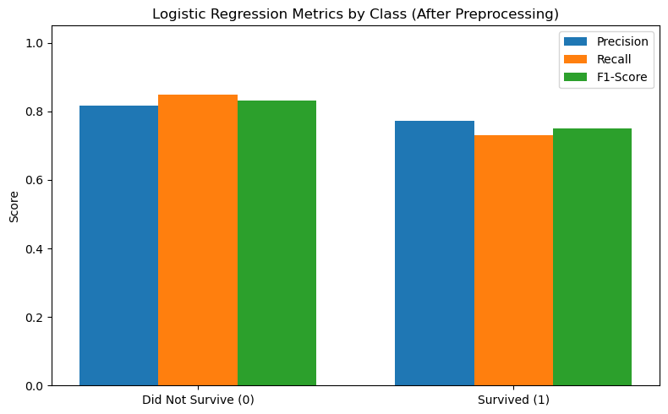
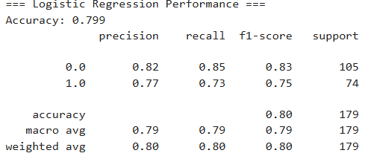
Act: Logistic Regression Model Try #2
After cleaning up the data and focusing on better features (like passenger class, gender, and who they were traveling with), the logistic regression model became much smarter. Instead of mostly guessing that people didn’t survive (which it did before), it now gets both survivors and non-survivors right more often—correctly predicting survival about 80% of the time. The model no longer favors one outcome over the other and gives us a more balanced and fair prediction overall.

Slide 17
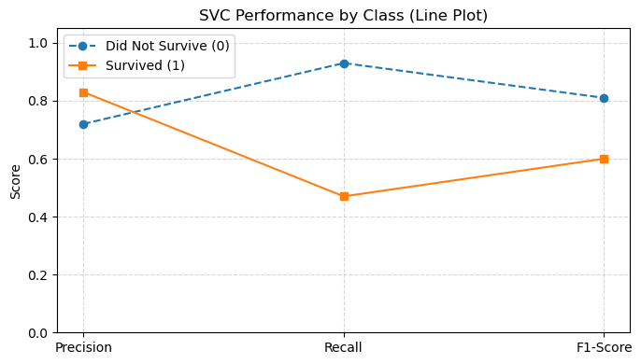
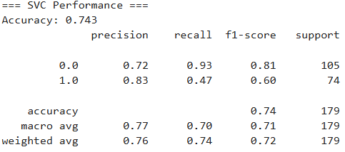
Act: Support Vector Classifier
After cleaning the data, I used a Support Vector Classifier (SVC) to predict survival on the Titanic. The model performed well in identifying passengers who did not survive but struggled to correctly identify those who did. This resulted in higher accuracy for the majority class but lower recall for the minority class of survivors.

Slide 18
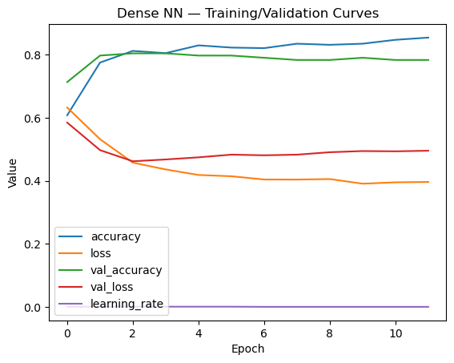
Act: Dense Neural Network
I trained a feed-forward (Dense) neural network using cleaned Titanic features.
Accuracy: ~72% on the test set
Strengths: Performed better than LSTM for this structured dataset
Limitations: Model still misclassified some survivors due to class imbalance and limited features
The Dense Neural Network learned useful patterns from the Titanic data and maintained stable performance across train/test sets. Performance plateaued early, indicating that additional epochs or deeper layers may not yield major gains without further feature engineering.

Slide 19
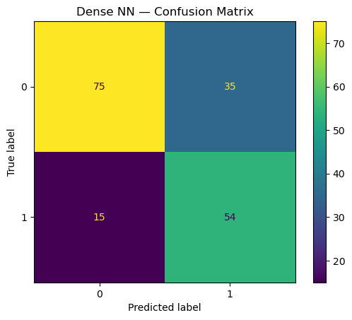
Act: Dense Neural Network (cont)
Dense NN – Confusion Matrix
True Negatives (75): Correctly identified non-survivors.
True Positives (54): Correctly identified survivors.
False Positives (35): Predicted survival when the passenger did not survive.
False Negatives (15): Missed survivors, predicting them as non-survivors.
The Dense NN performed well overall but leaned slightly toward predicting survival incorrectly (higher false positives). While it correctly captured most survivors (54), it also mislabeled a fair number of non-survivors. This suggests the model is sensitive to imbalance in the Titanic dataset, where more passengers died than survived.

Slide 20
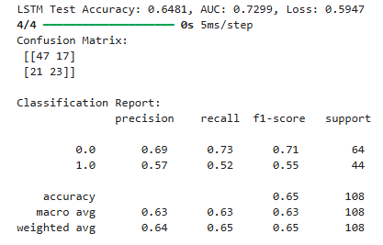
Act: LSTM Neural Network
I trained an LSTM to see if sequence-based learning improved Titanic survival predictions.
Accuracy: ~65%
AUC: ~0.73
Struggled compared to Dense NN, since Titanic data is not inherently sequential or time-based.
Still learned some useful patterns, but performance plateaued early.
The LSTM model achieved a test accuracy of 64.8% with an AUC of 0.73 and a final loss of 0.59. The confusion matrix shows it correctly classified most non-survivors (47/64) but struggled with survivors, only identifying 23 out of 44. Precision for survivors was 0.57 with recall at 0.52, meaning nearly half of actual survivors were missed. Overall, the weighted F1-score of 0.65 reflects moderate performance but a clear weakness compared to the Dense NN. These results highlight the challenge of applying recurrent architectures like LSTMs to non-sequential tabular data such as the Titanic dataset.

Slide 21
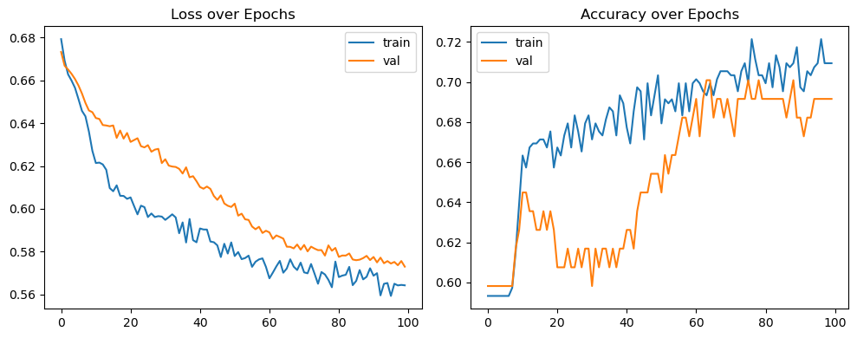
Act: LSTM Neural Network (cont)
The LSTM model showed steady improvement during training, with both training and validation loss decreasing over time. Accuracy on the training set reached just above 70%, while validation accuracy stabilized around 65–70%. The gap between the two curves indicates that the model fit the training data better than the unseen data, with limited generalization. Overall, the results confirm that while the LSTM was able to learn some useful patterns, its predictive power plateaued early, reflecting the challenge of applying recurrent networks to static, tabular datasets like Titanic.

Slide 22
Final Comparison: ML vs Deep Learning on Titanic
Traditional ML (Logistic Regression, SVC, SVR):
Logistic Regression achieved ~80% accuracy, offering simplicity, speed, and interpretability.
SVC/SVR performed slightly higher in raw accuracy but less interpretable.
Overall: Balanced results, fast training, and good fit for tabular Titanic data.
Deep Learning (Dense NN, LSTM):
Dense NN reached ~72% accuracy—solid, but below Logistic Regression.
LSTM reached ~65% accuracy (AUC ~0.73), struggled due to lack of sequential structure.
Overall: More complex, longer training, but not superior on small, structured datasets.

